Slide 1
Merge Sort

Slide 2
Merge Sort
Explanation of Merge Sort
Visualization of Merge Sort
Implementation of Merge Sort

Slide 3
Merge Sort
Merge sort is a recursive algorithm that continually splits a list in half.
If the list is empty or has one item, it is sorted by definition (the base case).
If the list has more than one item, we split the list and recursively invoke a merge sort on both halves.

Slide 4
Merge Sort
Once the two halves are sorted, the fundamental operation, called a merge, is performed.
Merging is the process of taking two smaller sorted lists and combining them together into a single, sorted, new list.

Slide 5
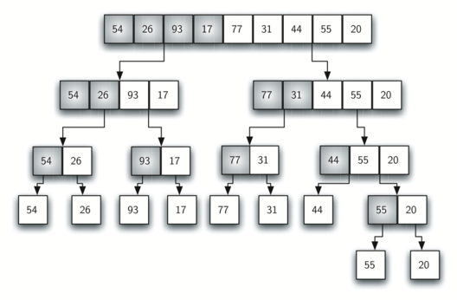
Merge Sort

Slide 6
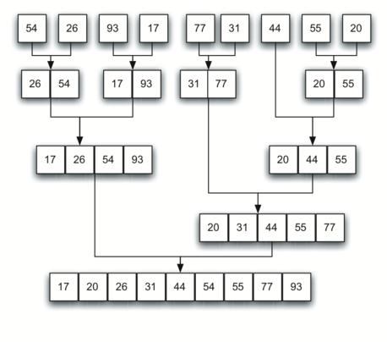
Merge Sort

Slide 7
Visualizations
Let’s take a look at some visualizations!

